Slide 1
Hybrid-AI
9:00-9:15: Welcome
9:15-10:45: Introduction into hybrid machine learning
10:45-11:00: Break
11:00-11:45: Introduction time series, data processing, data alignment
11:45-12:45: Lunch
12:45-13:45: Hands on session time series, data processing, data alignment
13:45-14:00: Break
14:00-15:00: Introduction PINNs
15:00-16:00: Hands on session PINNs

Slide 2
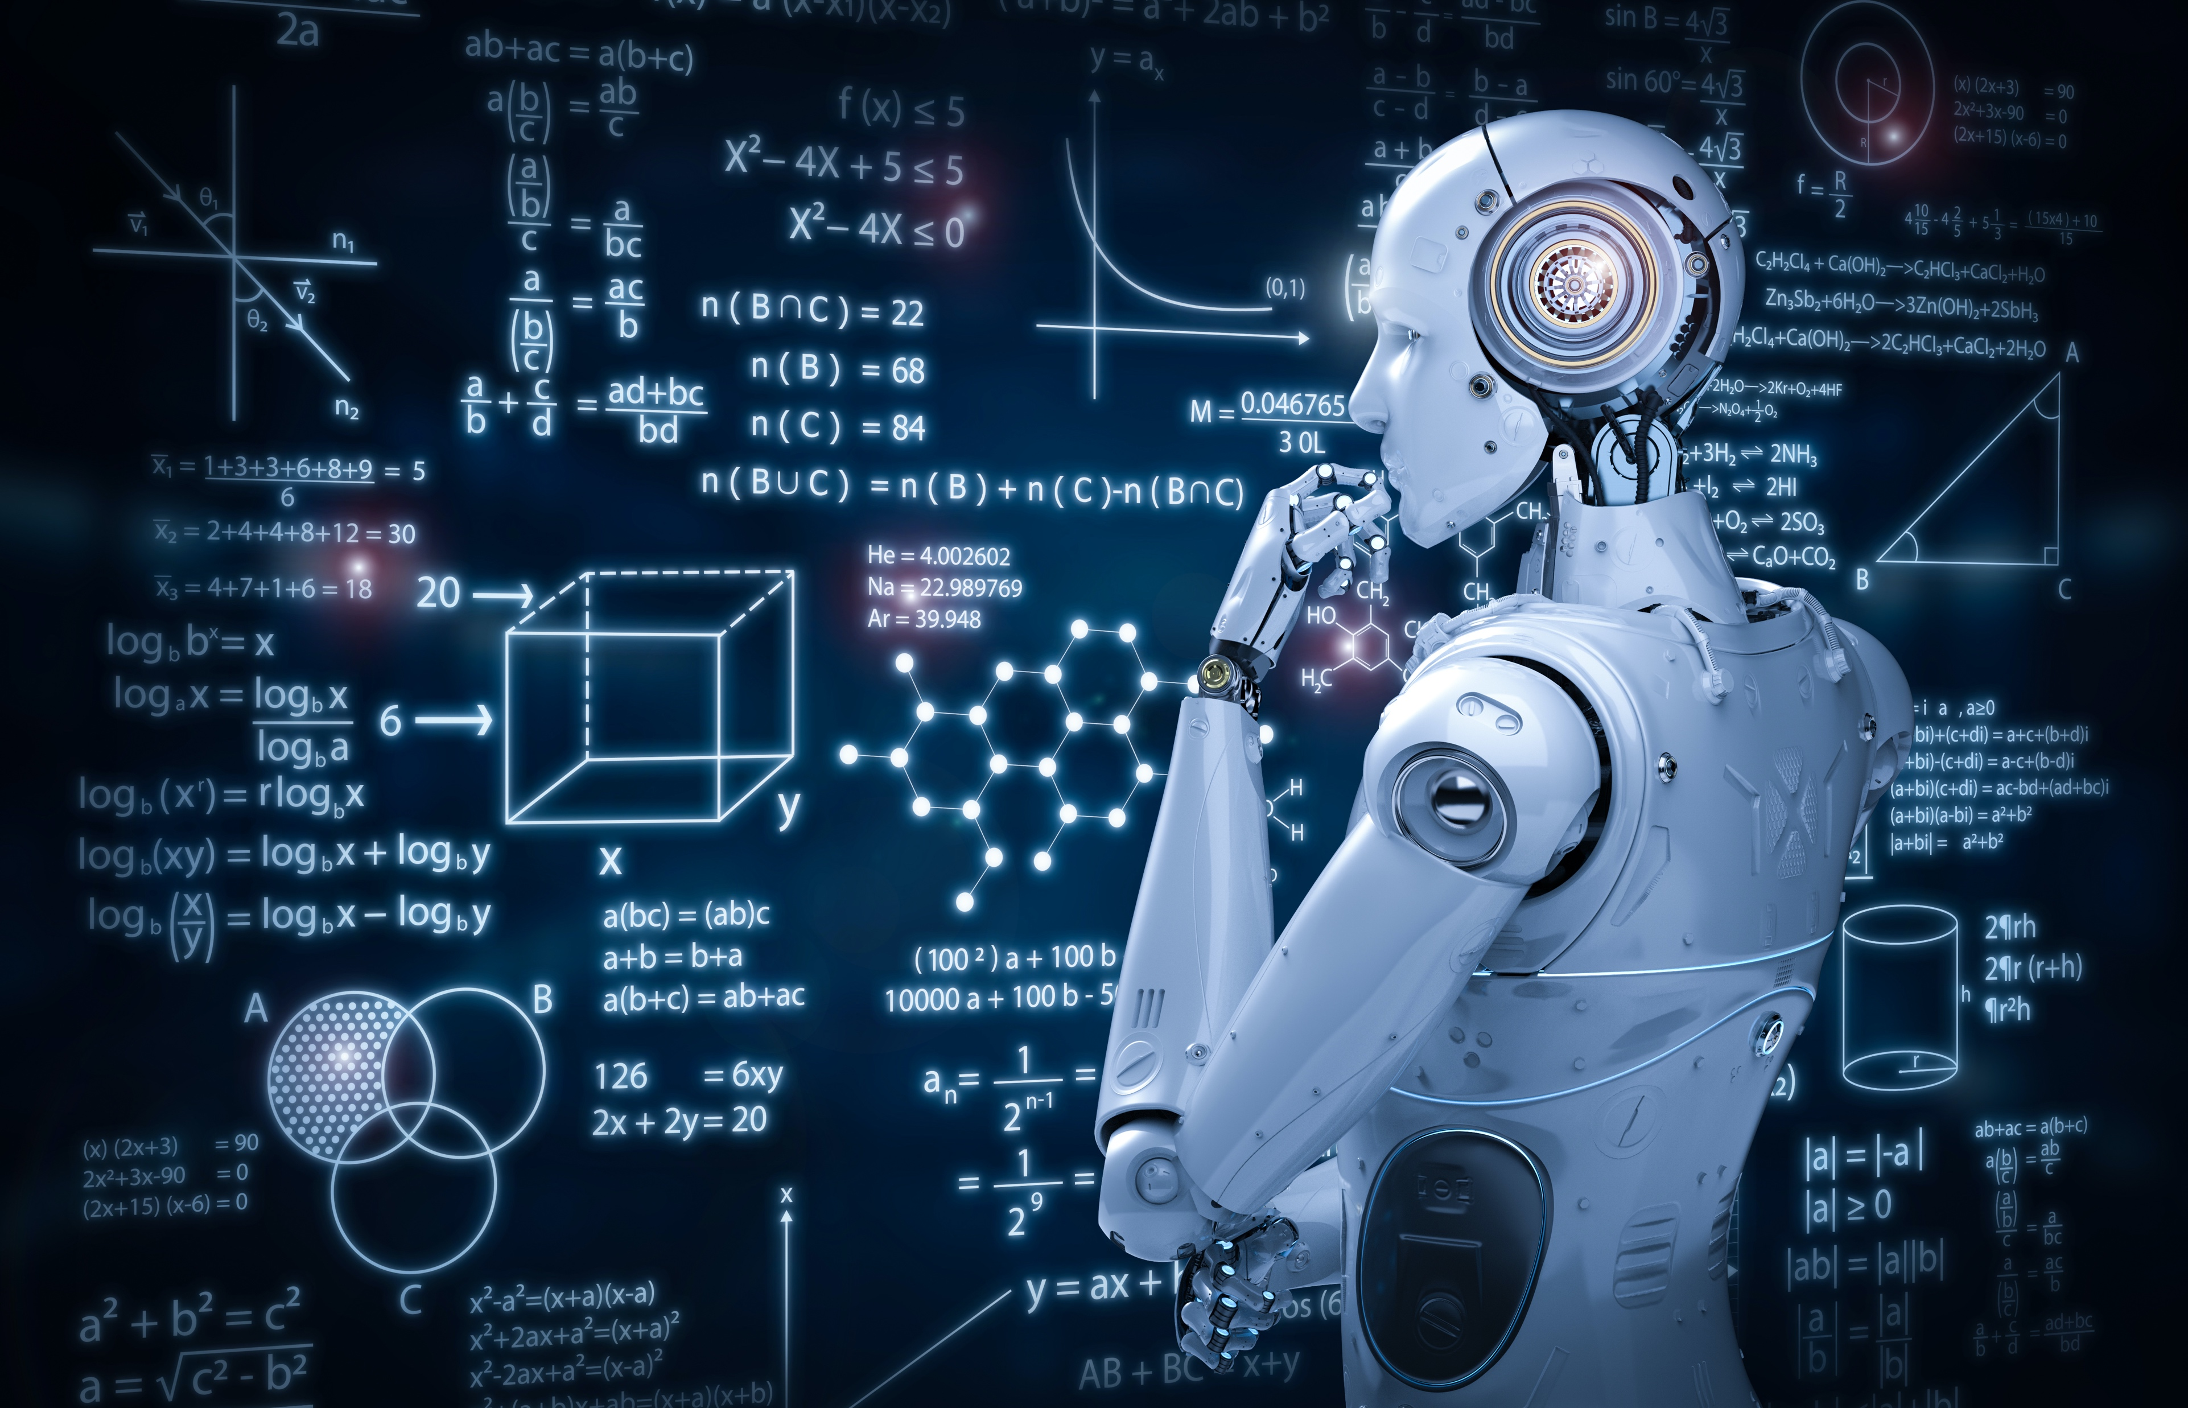

Physics and machine learning
Signe Riemer-Sørensen, Analytics and AI, SINTEF Digital
Notes:
Thank the organisers for the initiative and the invitation to speak
My title is physics and machine learning but it could also have been «The failures of applying machine learning in industry and possible solutions»
(There will be a test at the end)

Slide 3

What happens?
You have a ball of 1kg attached to a 1m spring, which is attached horizontally to a wall. The spring constant is 1 and the spring is extended by 10 cm.
Describe briefly what happens in real life when you let go of the ball.

Slide 4
What happens?
You have a ball of 1kg attached to a 1m spring, which is attached horizontally to a wall. The spring constant is 1 and the spring is extended by 10 cm.
Describe briefly what happens in real life when you let go of the ball.

Slide 5
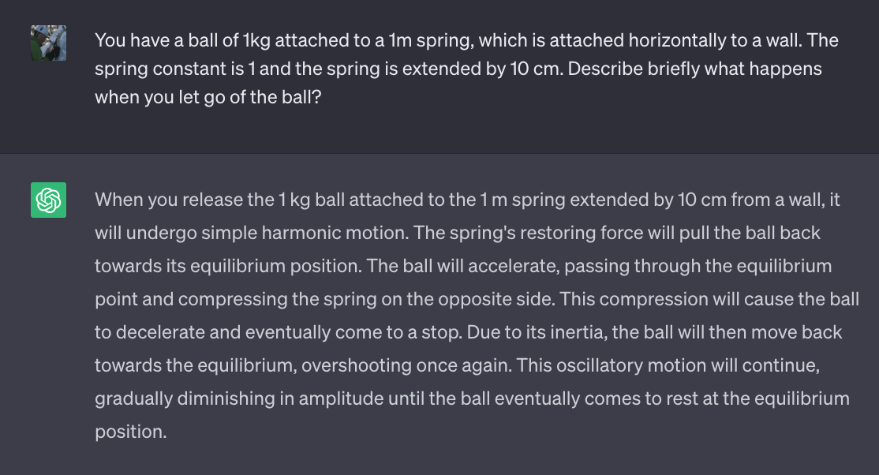
Why ChatGPT doesn’t solve the problem
Notes:
ChatGPT has read/seen many more books on classical mechanics than I have. And you can get it to give detailed answers with all the equations etc. But the answer is still wrong – ChatGPT ignores implicit knowledge.
You have a ball of 1kg attached to a 1m spring, which is attached horizontally to a wall. The spring constant is 1 and the spring is extended by 10 cm. Describe briefly what happens when you let go of the ball?
ChatGPT> When the 1 kg ball attached to the 1 m spring extended by 10 cm is released, it will undergo simple harmonic motion. The spring's restoring force will pull the ball back towards its equilibrium position. As the ball moves towards equilibrium, the spring force decreases, and the ball's kinetic energy converts to potential energy as it compresses the spring. The ball momentarily stops at equilibrium before continuing in the opposite direction due to inertia. The process repeats, causing oscillatory motion around the equilibrium point. Over time, energy is gradually lost due to factors like air resistance and friction, causing the amplitude of oscillation to decrease until the ball eventually comes to rest at the equilibrium position
How about gravity? Give a brief answer
ChatGPT> Gravity contributes to the ball's motion by adding to the restoring force when the ball is compressed and opposing its motion when it overshoots the equilibrium position. It also plays a role in energy loss through damping over time.

Slide 6
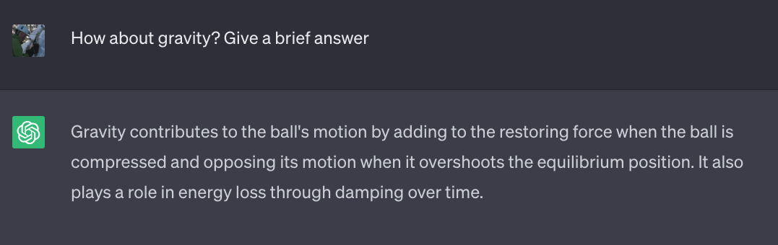
Why ChatGPT doesn’t solve the problem
Notes:
ChatGPT has read/seen many more books on classical mechanics than I have. And you can get it to give detailed answers with all the equations etc. But the answer is still wrong – ChatGPT ignores implicit knowledge.
And if in doubt, ChatGPT doesn't ask, it just assumes.
We need people to ask questions, domain knowledge
You have a ball of 1kg attached to a 1m spring, which is attached horizontally to a wall. The spring constant is 1 and the spring is extended by 10 cm. Describe briefly what happens when you let go of the ball?
ChatGPT> When the 1 kg ball attached to the 1 m spring extended by 10 cm is released, it will undergo simple harmonic motion. The spring's restoring force will pull the ball back towards its equilibrium position. As the ball moves towards equilibrium, the spring force decreases, and the ball's kinetic energy converts to potential energy as it compresses the spring. The ball momentarily stops at equilibrium before continuing in the opposite direction due to inertia. The process repeats, causing oscillatory motion around the equilibrium point. Over time, energy is gradually lost due to factors like air resistance and friction, causing the amplitude of oscillation to decrease until the ball eventually comes to rest at the equilibrium position
How about gravity? Give a brief answer
ChatGPT> Gravity contributes to the ball's motion by adding to the restoring force when the ball is compressed and opposing its motion when it overshoots the equilibrium position. It also plays a role in energy loss through damping over time.

Slide 7
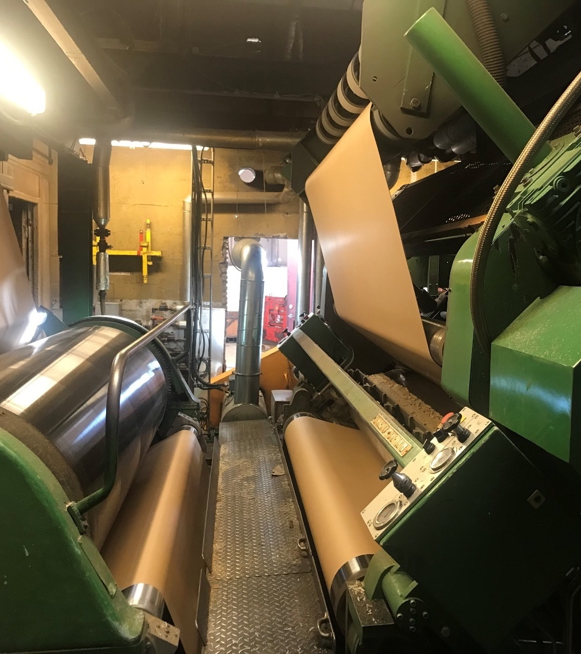
Why is this one not controlled by AI?
Notes:
The correct answer: It is not digitized. It doesn’t have sensors, measurements are manual and to be fair, it was also decommissioned in 2020

Slide 8

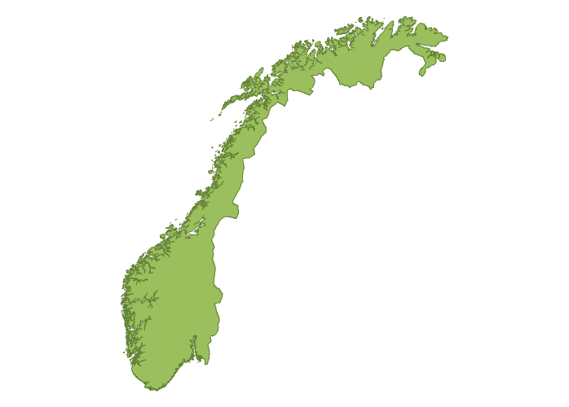

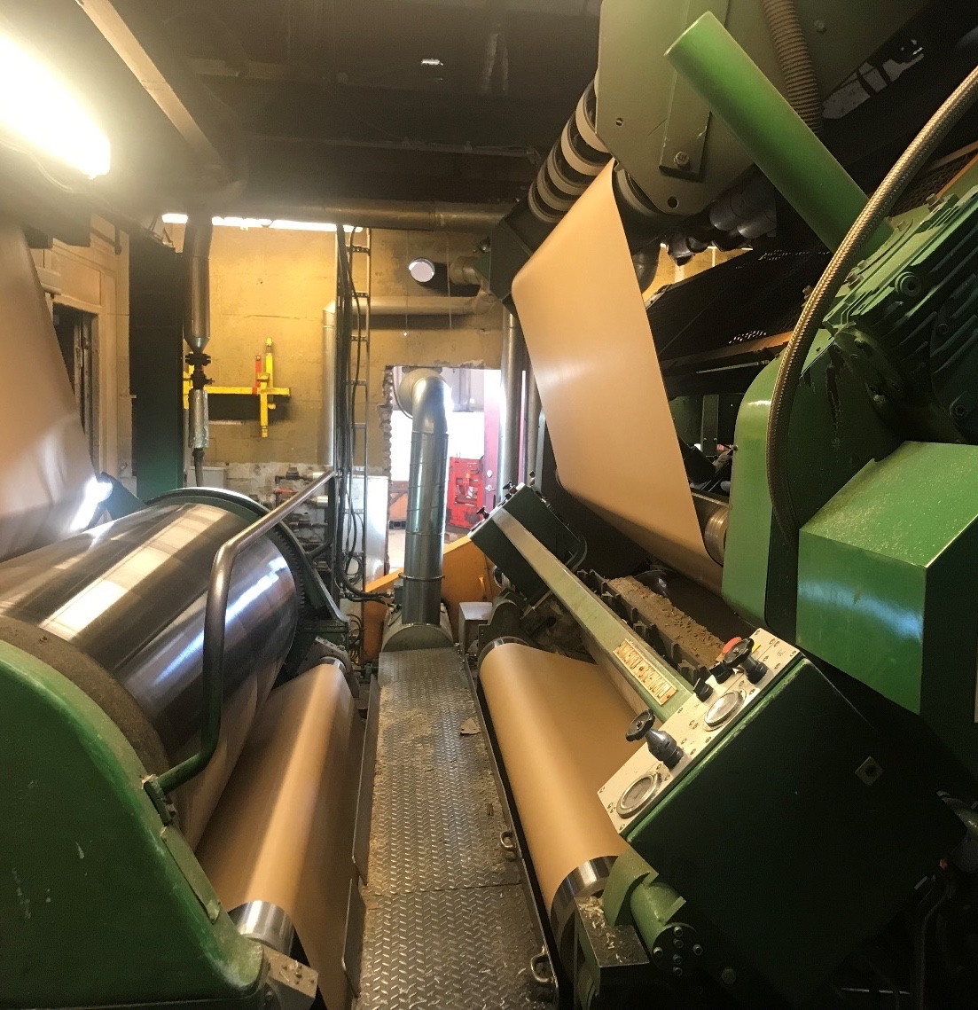

Warped cardboard
Example: Data is challenging
VPK Peterson
2 100 000m²/year scrap
Moist and temperature
Measure and model correlation
Recommendations for new factory and AI
Notes:
Warped cardboard is a major quality issue in the production of corrugated cardboard. It reduces the productivity in the converting units, causes reduced quality on the final product, and increases waste.
VPK Peterson, Norway’s biggest producer of corrugated board.
This year they have build a new and super fancy factory in Halden
Even here warp is a problem
Approximately 2 100 000 m² (or 295 soccer fields, almost 1 meter thick coverage of 1 field) corrugated board at 5 NOK/m² is scrapped every year. Consequently, the plant has a yearly expense of over 10 000 kNOK just from scraps caused by warp.
The operators know that to avoid warped cardboard they can adjust temperature and moisture, but they don’t have any guide lines and some operators are better than others.
Peterson came to SINTEF and asked if we could provide any recommendations.
Turned out that the old machine didn’t have any sensors, so to investigate the warp, they spent 6 months collecting manual measurements
The new machine has lots of sensors, but the data are difficult to get out of the closed system…

Slide 9
Data is challenging
Manual measurements
Noisy sensors
Harsh conditions prevent measurements
Proxy measurements
Irregularly or sparsely sampled
Small sets of data
Notes:
However, industry has a huge advantage! They often know something about the system they want to model/control
Starting point for Cognite ;)

Slide 10

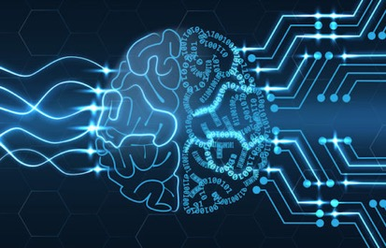
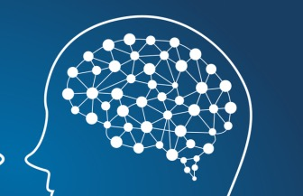
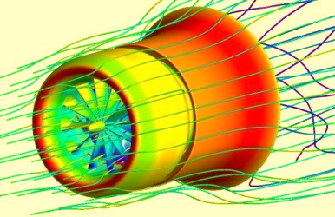
Why?
Data size
Physical understanding
Explainability and safety
Machine learning
Data-driven methods
Hybrid analytics
Combining data-driven and model-based methods
Use of data
F(a) = ma
E = mc²
Analytical model
Knowledge/physics-based
High-fidelity simulation
Complex physical model
Complexity of physical/knowledge base
Notes:
Figure illustrates different types of model building
Traditional model development:
Hypothesis -> model/equations -> data collection and analysis -> conclusion
If it gets complicated then you do simulations
Data driven:
Data -> analysis and conclusion, no model?
Hybrid analytics, one way of integrating machine learning and physics
Emerging field, research area, not of-the-shelf solutions
Why use hybrid analytics?
Not all problems have big data
most research problems have small data
Physical understanding may be important
some models already exist
Explicability and safety
extrapolation

Slide 11
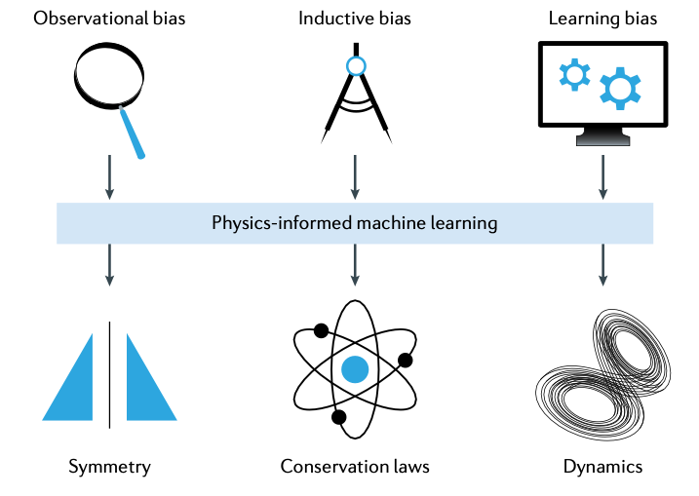
Notes:
First of all, when we impose knowledge on our model, we bias it. We bias it towards something we believe to be true. This must be a concious decision!
Three types of constraints
Observational bias
Use training data that obeys specific laws of physics
Can be achieved via data augmentation (mirror symmetry, translational invariance)
Does not come with any guarantees
Learning bias
Modify loss function to account for physical constrains (physics informed neural networks)
Very general and flexible, easy to implement
Does not come with guarantees
Adds additional hyperparameters to the problem
Inductive bias
Specific form of model can guarantee certain properties
Hard to implement, not always possible
At the moment, limited to selected cases (Hamiltonian NN seems to be the way to go, port-Hamiltonian framework can also take energy losses etc. into account)

Slide 12
Notes:
First of all, when we impose knowledge on our model, we bias it. We bias it towards something we believe to be true. This must be a concious decision!
Three types of constraints
Observational bias
Use training data that obeys specific laws of physics
Can be achieved via data augmentation (mirror symmetry, translational invariance)
Does not come with any guarantees
Learning bias
Modify loss function to account for physical constrains (physics informed neural networks)
Very general and flexible, easy to implement
Does not come with guarantees
Adds additional hyperparameters to the problem
Inductive bias
Specific form of model can guarantee certain properties
Hard to implement, not always possible
At the moment, limited to selected cases (Hamiltonian NN seems to be the way to go, port-Hamiltonian framework can also take energy losses etc. into account)

Slide 13
Observational bias
Use training data that obeys specific laws of physics
Can be achieved via
Feature engineering and/or data augmentation (mirror symmetry, translational invariance)
Convolutional filters (translational invariance)
Recurrent neural networks (signal shape independent of location in time series)
Graph representations (control data relations)
Does not come with any guarantees
Notes:
Observational bias

Slide 14
Pre-processing
Implement knowledge BEFORE model
Feature selection and engineering
Notes:
Guide model with knowledge
Opposite to end-to end-modelling

Slide 15
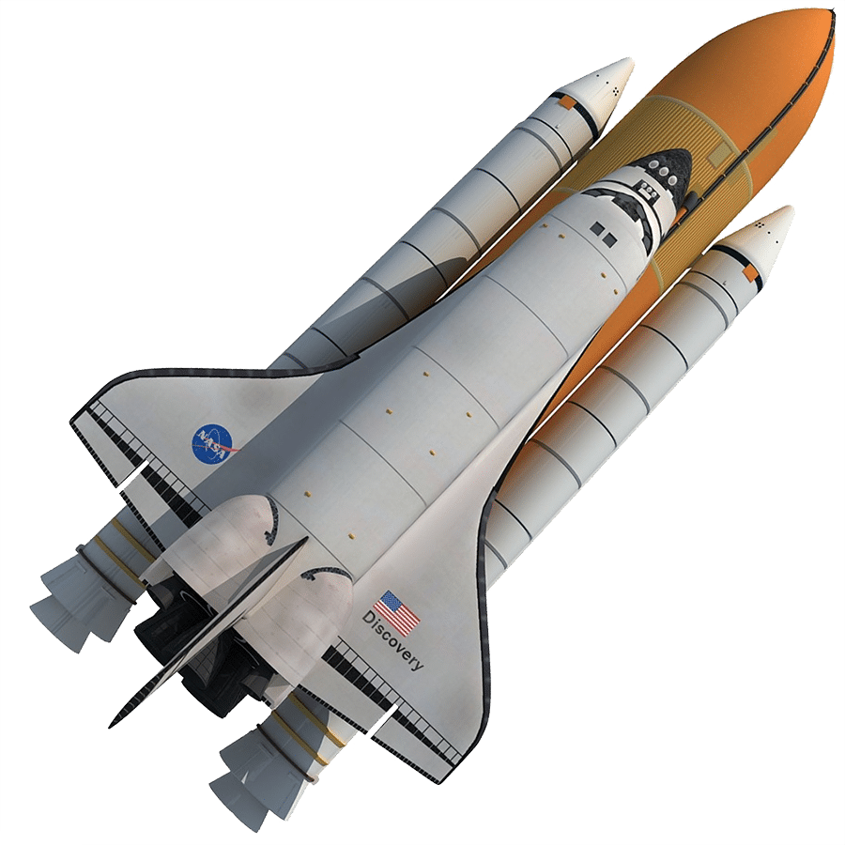
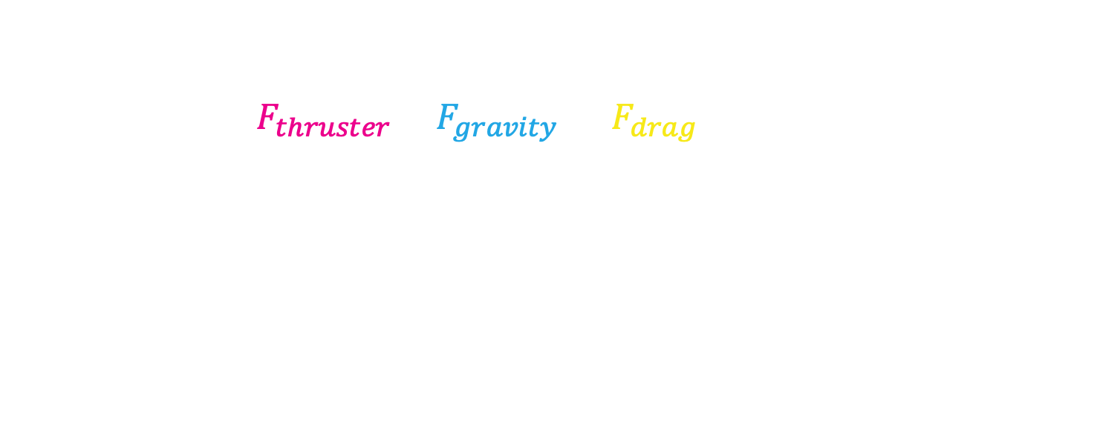
Hybrid models – minimising the black box
Replace part of theoretical model with data-driven model
$m\frac{d^{2}x}{dt^{2}}=F=F_{thruster}−F_{gravity} −$ $F_{drag}$
F_{thruster}
F_{drag}
F_{gravity}
Notes:
Another concept for pre-modelling combination physics and ML
Theoretical modelling as far as possible, then data science
Replace bits of theoretical model with data driven, e.g. Drag force for space shuttle
Use measured data for training
In some cases it may be used to model only part of a system, before modelling the rest with a neural network
Increase explicability, decrease spurious effects from extrapolations
There are frameworks for solving differential equations with neural network components (e.g. Sciml in julia, https://sciml.ai/news/2020/03/29/SciML/)

Slide 16
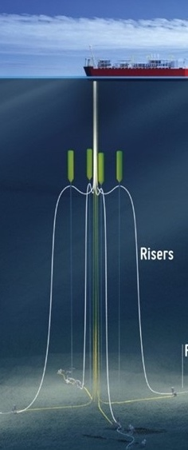
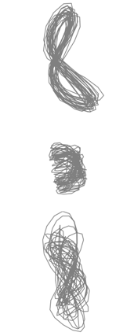

Slender marine structures
Example: Feature engineering
How does pattern depend on current directionality?
Controlled experiment
Only current perpendicular to riser
Weak current along riser
Strong current along riser
Technobleak.com
Notes:
Slender marine structures, oil risers or mooring lines
Drag force from turbulence
Vibrations lead to fatigue
Existing models based on simplifications (2D current, calibrations to experimental data from unrealistic conditions)
Do the patterns depend on current along the riser?
Tow tank eksperiment where the current was controlled, with no current along the riser, weak current along the riser and strong

Slide 17
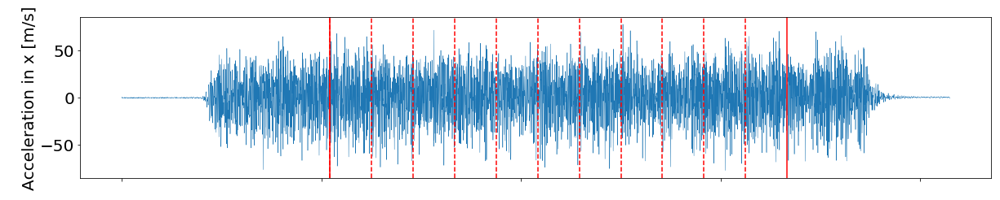
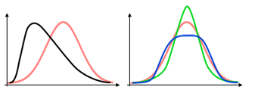
Slender marine structures
Example: Feature engineering
Riemer-Sørensen et al. 2019
Scratchapixel.com
Technobleak.com
Notes:
Measure acceleration
Chop in short time intervals
Compute mean and standard deviation
But we also know that random motion has a very gaussian distribution while systematic motion will be narrower and more tailed
Measure for that is called kurtosis (the kurtosis = fourth moment will be 3)
Skewness

Slide 18
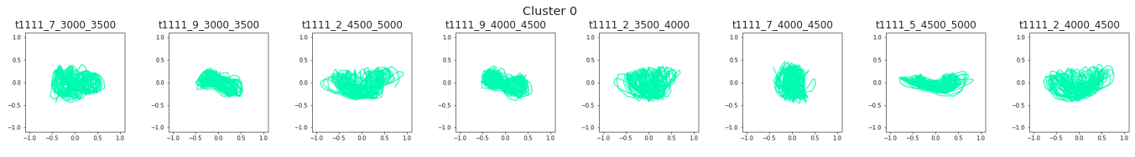
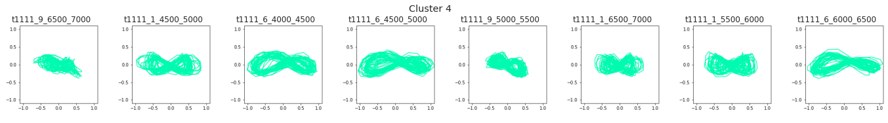
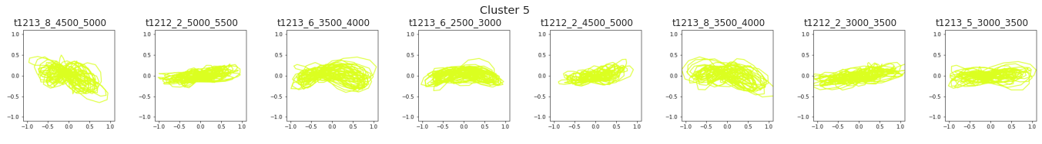
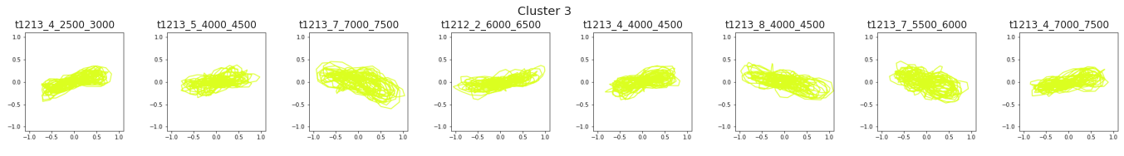
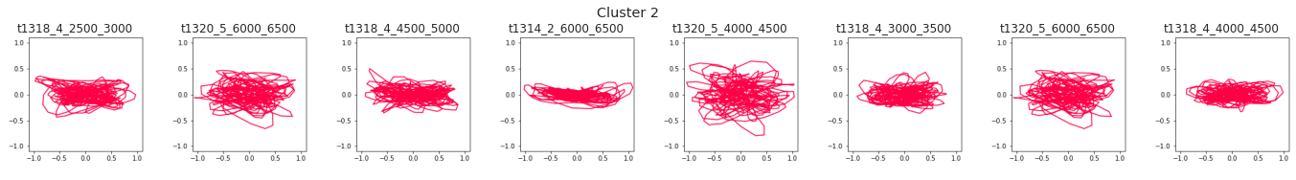
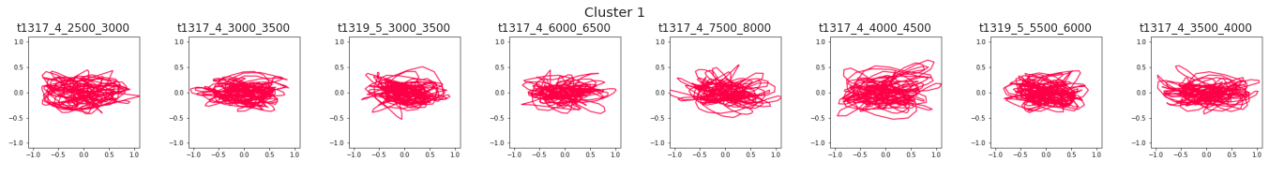
Slender marine structures
Example: Feature engineering
Riemer-Sørensen et al. 2019
Technobleak.com
Notes:
Clustering on 8 statistical parameters (sigma X/Y, kur X/Y, freq post X/Y, velocity X/Y)
Algorithm has never seen images and it doesn’t know anything about the current!
Green: only perpendicular current
Yellow: weak inline current
Red: Strong inline current
Notice how the clusters have similar shape of patterns AND all cluster members belong to same type of current even if some of them could look similar (red and yellow at the end)
So with physical knowledge about the features I reduced the set of features significantly and got meaningful clusters

Slide 19

Give an example of informative features
Notes:
Open discussion?

Slide 20
Learning bias
Modify loss function to account for physics (physics informed neural networks)
Very general and flexible, easy to implement
No guarantees
May add additional hyperparameters to the problem

Slide 21
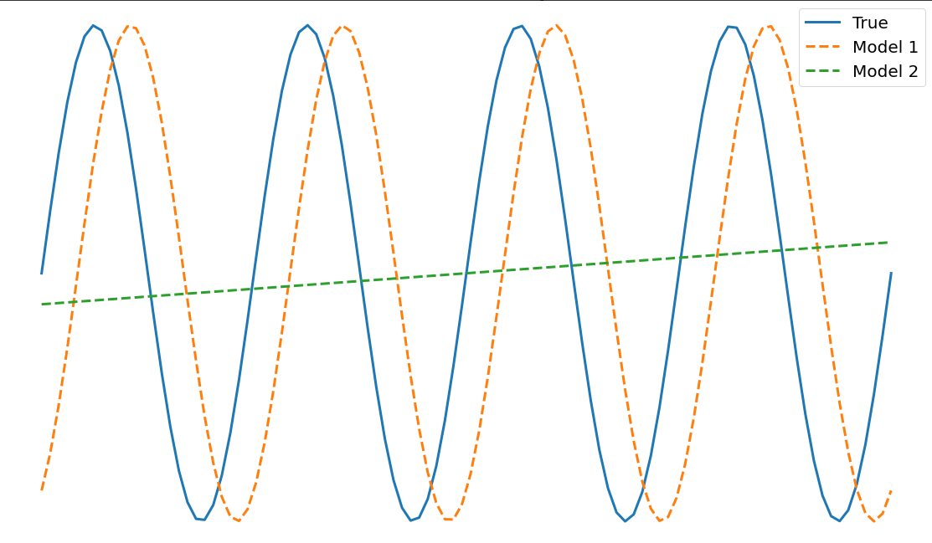
Which model is best, green or orange?
Notes:
Which model is best?
Both models (green and orange) have same root mean squared error
More about this later today

Slide 22
Theory guided models
Performance measure
Accuracy + consistency
Loss function =
measure of difference between model and data +
reward for consistency between model and knowledge
Notes:
How do we quantify the performance of our model
«loss» is the quantity the algorithm is trying to minimize
Think of chi2 that describes how well a model fits
Build physics into loss function

Slide 23
Theory guided models
Performance measure
Accuracy + consistency + simplicity
Loss function =
measure of difference between model and data +
reward for consistency between model and knowledge +
specific parameter combinations (equations)
specific relations (e.g. monotonic)
penalisation for complexity (Occam’s razor)
Notes:
Can be described different ways
Often we know that the underlying processes are (relatively speaking) simple, so we may also encourange simplicity

Slide 24
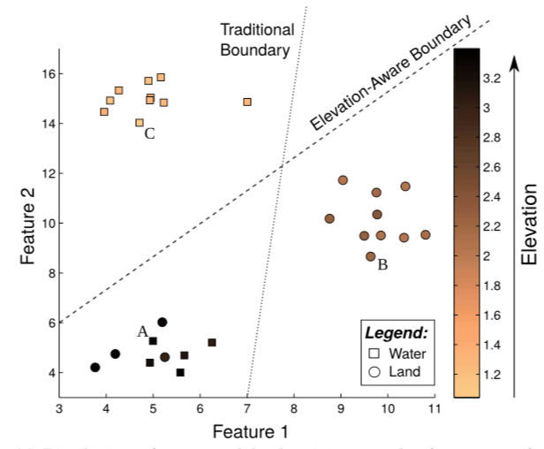
Categorising land and water
Example: Adding physical conditions
Karpatne et al. 2016
Notes:
Labelling satelite data (lake or land)
Imperfect labels in the training data
Add a physical condition: Elevation (water cannot be above land)
Condition moves seperation boundary.

Slide 25
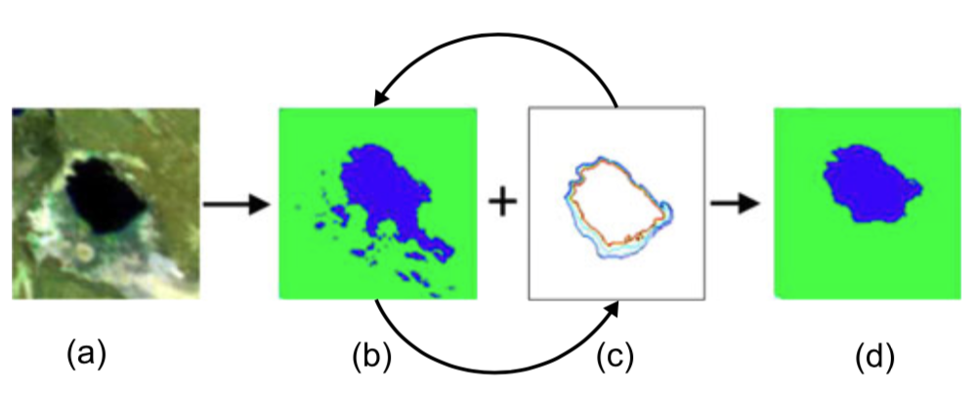
Refine output with existing knowledge
Explicit domain knowledge
Equations
Implicit domain knowledge
E.g. historic behaviour
Karpatne et al. 2016
Khandelwal et al. 2015
Notes:
E.g. use history of labelling
Mapping the extent of Lake Abhe (on the border of Ethiopia and Djibouti in Africa)
Remote sensing image of the water body (prepared using multi-spectral false color composites)
Initial classification maps.
Elevation contours inferred from the history of classification labels.
Final classification maps refined using elevation-based constraints.

Slide 26
Physics informed nets
Solutions to non-linear partial differential equations
Discovery of non-linear partial differential equations
Notes:
Discover solutions to partial differential equations
Discover non-linear partial differential equations
Available on github
I will try to give an intuitive explanation of the simplest case, and refer to the paper for the more complicated
WARNING: Next slide may be a little ”heavy” on the maths side, but don’t worry, even if you get lost, you can still follow the rest of the lecture

Slide 27
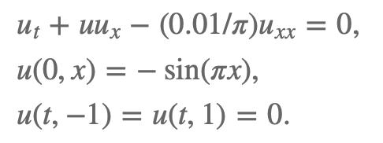
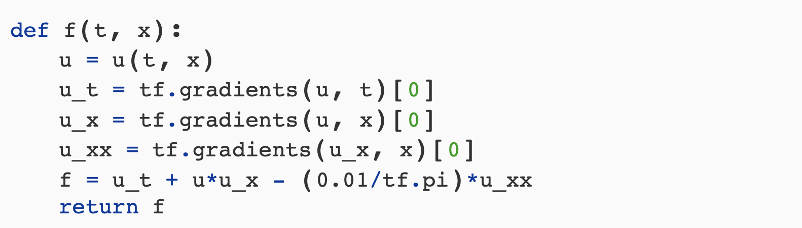
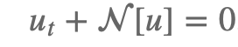
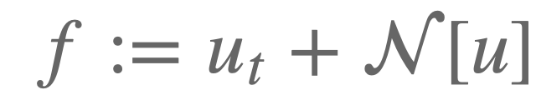
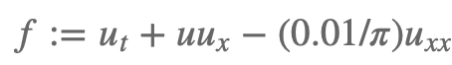
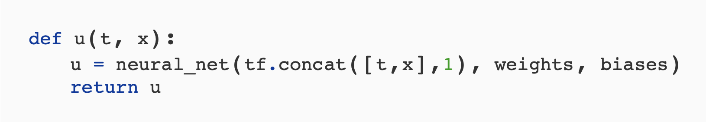
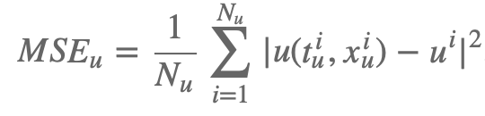
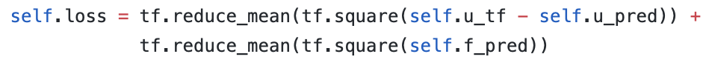

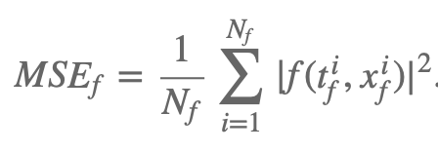
Solutions to differential equations
General
Example (Burgess)
Code
Represent u(t) with NN
Notes:
Differential equation, N[⋅] is a nonlinear differential operator
Define the function f
Represent u(t,x) by a deep neural network
Define the loss function based on f AND u
Fit the neural network to your data, the result will now be (softly) limited by the differential equation
Example: Burgess equation
Equation and initial conditions
How it would look in code
Define f, and u as a NN
Define loss functions
The loss MSEu corresponds to the initial and boundary data
MSEf enforces the structure imposed by the Burgers’ equation at a finite set of collocation points.

Slide 28
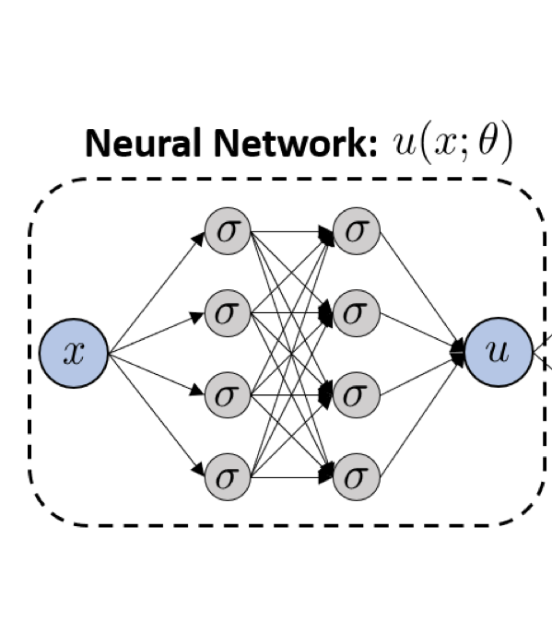
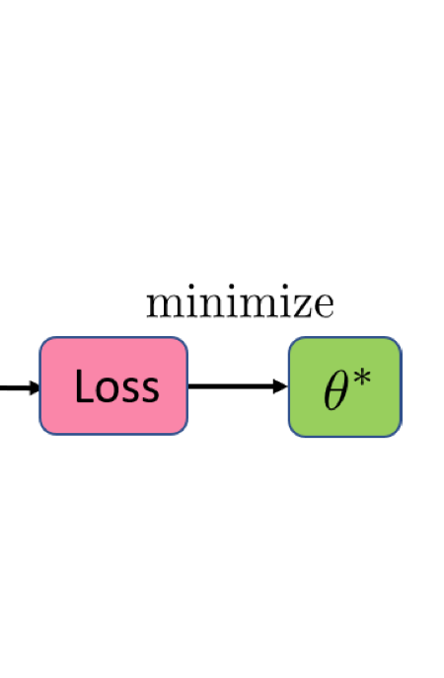
Concept
Optimise θ to minimise
Loss ∝ |ũ – u|
Figure from Shin et al. 2020
Notes:
NN to predict u
Standard NN optimise weights to minimise difference between prediction and actual value

Slide 29
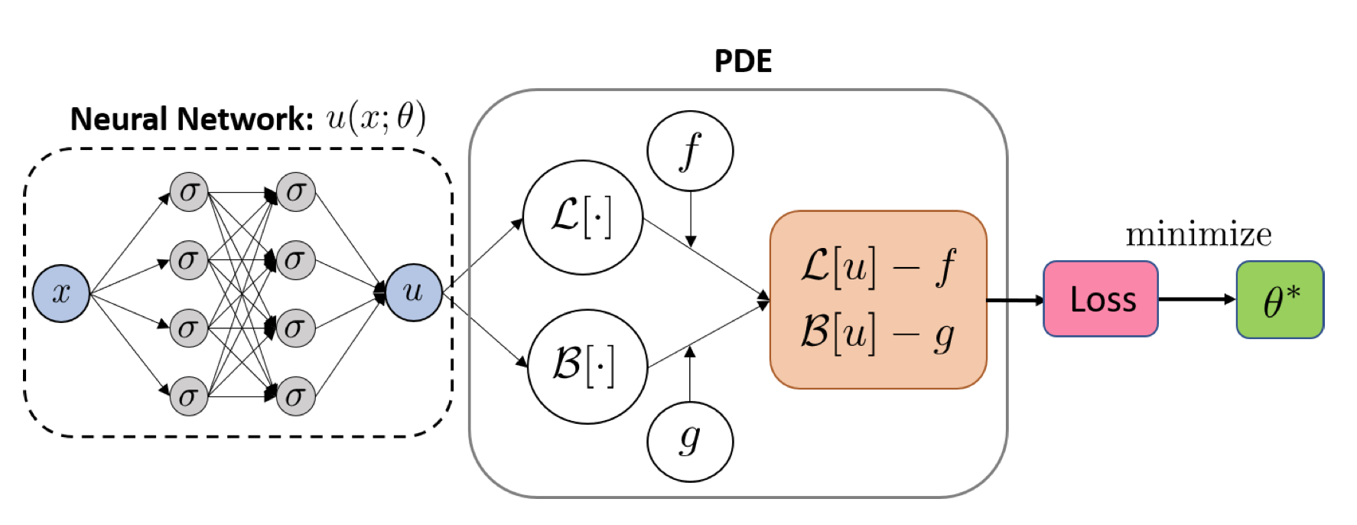
Concept
Optimise θ to minimise
Loss ∝|ũ – u| + (ℒ[u] – f) + (ℬ[u] – g)
Figure from Shin et al. 2020
Notes:
If u is governed by a differential equation, we can add the constraint to the loss
If the parameters of the PDE are unknown, they are optimised simultaneously
Neural network parameterized by θ, u(x, θ)
L is the differential operator, efficiently evaluated with automatic differentiation
B is the boundary operator
f, g are the PDE data obtained from randomly sampled points
Loss function is computed by evaluating L[u] and B[u] on the sample points. Minimizing the loss with respect to the network’s parameters θ produces a PINN u(x;θ∗), which serves as an approximation to the solution to the PDE.

Slide 30
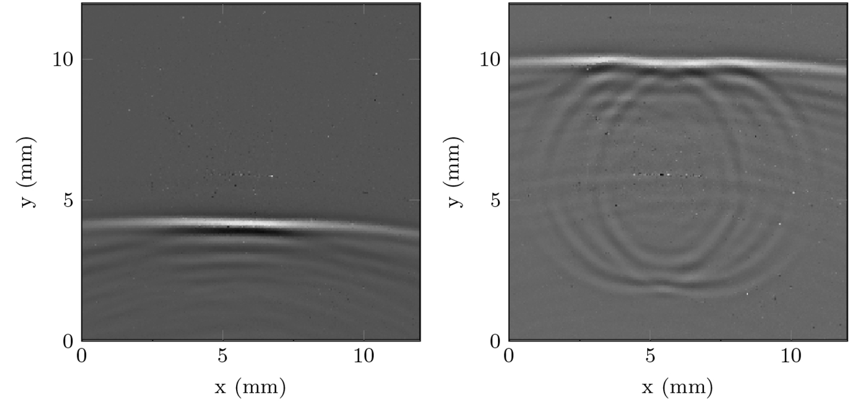
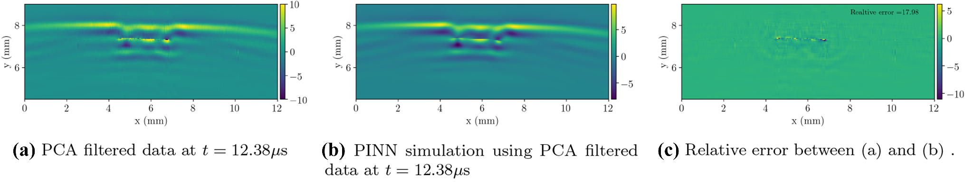
PINNs for ultrasound nondestructive quantification of surface breaking cracks
Example application from Shukla et al. 2020
Ultrasound propagation in metal with cracks
Wave propagation u_{tt} = v²(x,y) ∇u
Notes:
Example from paper
Cracks in metal plate will change ultrasound wavefront
Propagation of wavefront will change with cracks
Acoustic wave propagation described by linear second-order partial differential equation
Utt is second time derivative, u(t, x, y) is the solution, v(x, y) is the sound speed
given measurements u and want to learn v(x, y) that fulfils the equation
PINNS can compute the parameters or even unknown functions involved in the PDEs
Quite good performance (unfortunately no comparison to performance without PDE guiding) AND it provides the unknown sound speed as well!
Physics-Informed Neural Network for Ultrasound Nondestructive Quantification of Surface Breaking Cracks

Slide 31
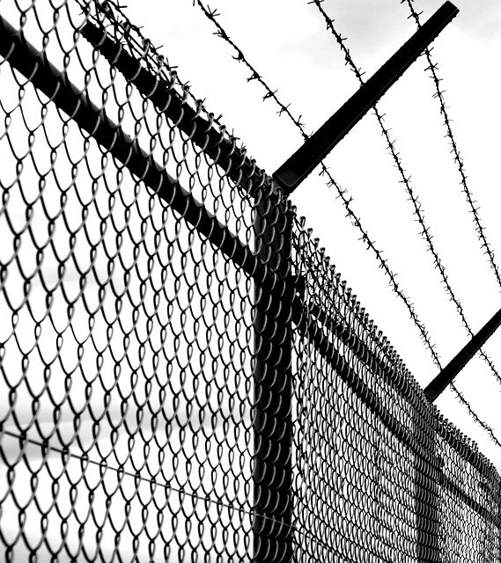
What are the limitations of learning bias?
Notes:
Primarily soft constraints

Slide 32
Inductive bias
Model guarantee certain properties
Rule based constraints
Model certainty (uncertainty)
Specific model structure
Hard to implement, not always possible
At the moment, limited to selected cases
Manual rules
Hamiltonian NN seems to be the way to go
port-Hamiltonian framework can also take energy losses etc. into account
Notes:
EVALUATE NEED FOR BREAK HERE

Slide 33

Plan a route from A to B
What are the hard constraints?
Are there any soft constraints?
A
B
Notes:
Hard:
Discard routes that go into water
Do not use train tracks
Do not crash other cars
Cannot drive outside roads
Soft:
Shortest route
Avoid traffic

Slide 34
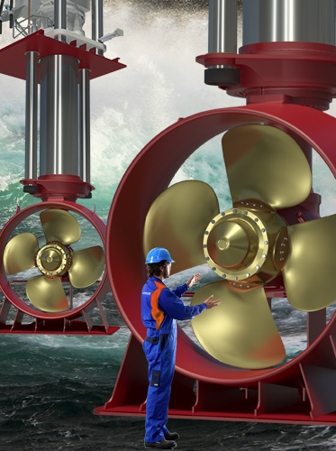
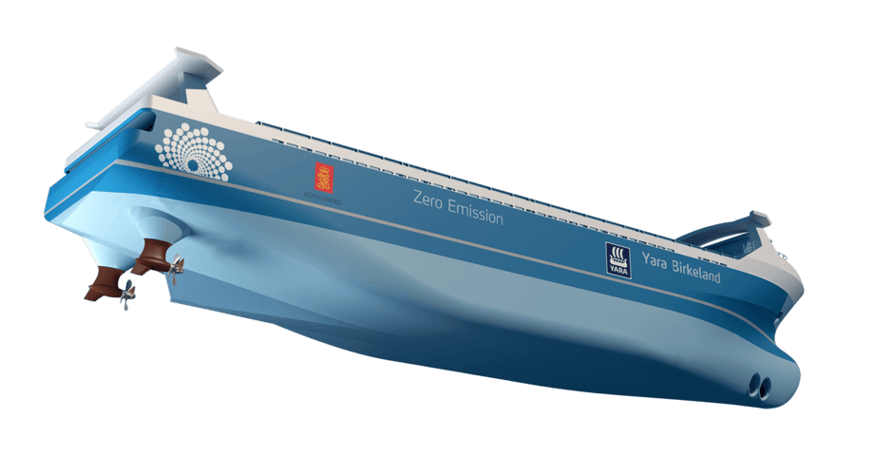
Oil level monitoring Example: Rule based boundaries
Monitor oil levels in ship propulsion systems (thrusters)
Brunvoll AS
Predictive maintenance and new service models
Notes:
An obvious way of ensuring physical behaviour is post-processing
Project with Brunvoll
Ship thrusters
Lubrication oil critical for maintenance and performance
Use sensor data to answer
Are they leaking
Are they serviced properly

Slide 35
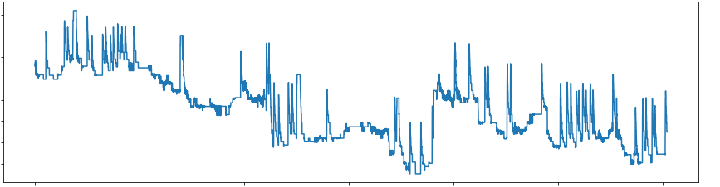
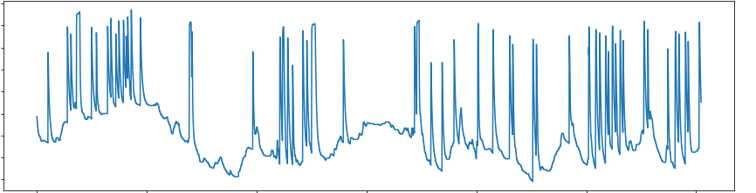
Oil level monitoring Example: Rule based boundaries
Oil level
Temperature
Time
Notes:
First simple task: Detect oil fillings
No labelled data to learn what a filling looks like -> look for steps
Oil level fluctuates with activity (temperature and pressure)
Filllings and drainings as part of service
Use temperature to remove activity related spikes

Slide 36
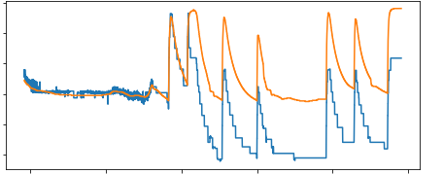
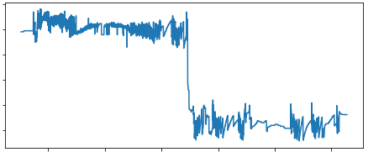
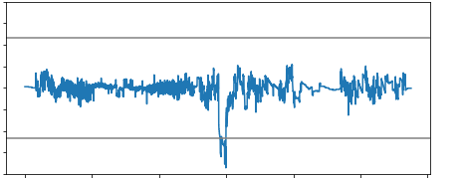
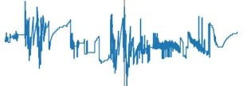
Oil level monitoring Example: Rule based boundaries
Oil level
Residuals
Time difference of residuals
Time
Time
Time
Notes:
Model the expected oil level from temperature (linear regression, LSTM/CNN not better)
(diff of) residuals to identify steps
Sometimes the algorithm detects a step e.g. due to a minor offset between oil level and prediction
Physical rules to ensure that it is a filling/draining
Big gap in oillevel and not in sumpoiltemp​
Median of residuals before and after differ
Each thruster is different, so it works with adaptive parameters

Slide 37
Safety cages: General idea
Input Data
ML Model
Prediction
Safety Layer
Input Data
ML Model
Trustable
Prediction
e.g. Henriksson et al. 2019
Notes:
Consider skipping!
In standard ML approaches, the model is trained to make the prediction "the best possible way”
But "best possible” is not the same as correct
Introduce a safety layer to check and validate the model's output
Different methods are possible, e.g.:
Check the "confidence" of the ML model in its prediction;
Compare model's output with other known (exact) outputs with similar inputs;
Allow the safety layer to access the internal parameters of the model during assessment.
Henriksson et al. 2019
https://arxiv.org/pdf/1903.01263.pdf

Slide 38
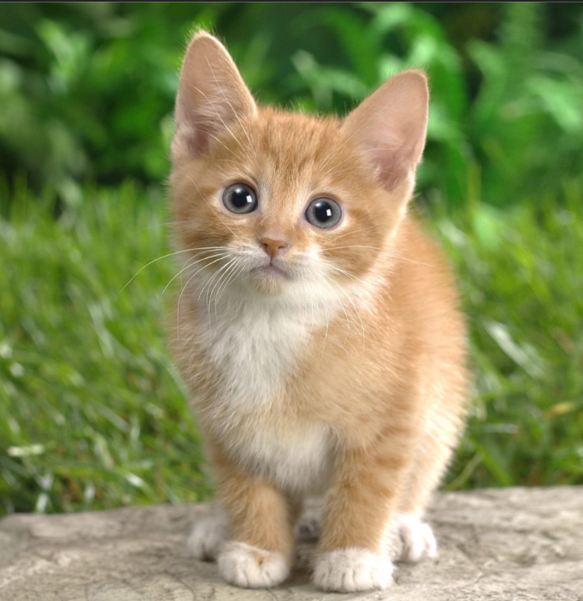
Example
Model trained with cat
32
Dog
Trainable parameters
78
Cat
Cat
argmax
13
Bird
17
Frog
Sure
Safety Layer
Notes:
Simplified example
We have a model that was trained with many images including cats
New prediction
The safety layer access the classes' probabilities and provide a ‘certainty’ because the percentage for cat is high (and even the distribution may be similar to training distribution)

Slide 39
Example
Model trained without cat
44
Dog
Trainable parameters
25
Rat
Dog
argmax
23
Bird
19
Frog
Unsure
Safety Layer
Notes:
How if the model was not trained with cats? Probabilities and certainties would be very different
In this example, the safety layer only uses the probabilities, but you can also use statistics on the entire set of neurons

Slide 40
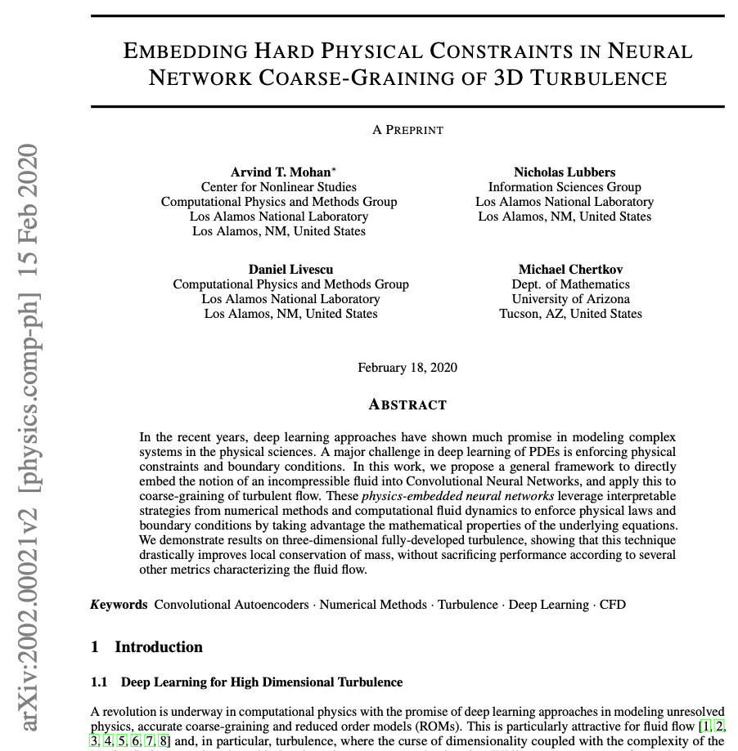
Hard constraints
Predict turbulence in incompressible fluid
Local mass balance:
∇∙V = 0
Notes:
First example on how to obtain ’hard constrained training’
No generic method, only a specific example on how to embed the incompressibility of a fluid into a learning bias in a NN
The use case is an attempt to produce low resolution (coarse) 3D flows from high dimensional data, without having to simulate the turbulence
An obvious constraint is the local mass balance where fluid cannot disappear
Represented by the divergence of the velocity field being zero (otherwise mass would appear/disappear)
Challenges:
Construct spatial derivative operators that are compatible with back-propagation
Velocity field is subject to boundary conditions
Hard constraints
2002.00021

Slide 41

Convolutional auto-encoder
Notes:
Auto-encoders are trained to reproduce the output BUT with a compression of information (basically a small layer in the middle)
Consider velocity field
How to ensure that the output is physically meaningful?

Slide 42

Physics constrained auto-encoder
Decomposition: V = 𝝯×A + 𝝯𝞅
CNN
CNN
Notes:
Helmholtz decomposition of velocity field into vector (A) and scalar (𝞅) potential
For periodic boundary conditions 𝞅 = 0

Slide 43
Physics constrained auto-encoder
Decomposition: V = 𝝯×A + 𝝯𝞅
CNN
CNN
Notes:
Helmholtz decomposition into vector (A) and scalar (𝞅) potential
For periodic boundary conditions 𝞅 = 0
Rather than training autoencoder to learn V~ , we let it learn A~ (supervised rather than true autoencoder)
but we simultaneously require that the curl of A~ is equal to V~

Slide 44
Physics constrained auto-encoder
Decomposition: V = 𝝯×A + 𝝯𝞅
CNN
CNN
Notes:
Helmholtz decomposition into vector (A) and scalar (𝞅) potential
For periodic boundary conditions 𝞅 = 0
The auto encoder learns A~ rather than V~
but we simultaneously require that the curl of A~ is equal to V~
For an equidistant mesh grid, CNNs can represent derivatives

Slide 45
Physics constrained auto-encoder
Decomposition: V = 𝝯×A + 𝝯𝞅
CNN
CNN
Notes:
Helmholtz decomposition into vector (A) and scalar (𝞅) potential
For periodic boundary conditions 𝞅 = 0
The auto encoder learns A~ rather than V~
but we simultaneously require that the curl of A~ is equal to V~
For an equidistant mesh grid, CNNs can represent derivatives
And we also need to represent the boundary conditions
The paper describe how to obtain them as non-trainable filters by using so called stensils and ghost cells.
In the end it reduces to ‘they can be described with CNNs without trainable parameters’

Slide 46


Performance vs
Notes:
Tested on simulated data
Compare divergence of V and turbulence statistics
Superior performance on the imposed criteria BUT both autoencoders perform well on the remaining turbulence statistics, in particular on medium/large scales, phyCAE better on small scales
Limitations/future challenges:
Non-uniform grid mesh
More general constraints (very problem specific)

Slide 47

What are some conserved quantities?
A
B
Notes:
Energy
Momentum
Mass
Charge

Slide 48

The mass-spring system in outer space
Ball attached to spring. Disregard gravity, friction and all other annoying facts.
$$F_{spring}=−D(x−x_{0})$$
$$F_{movement}=ma=m\ddot{x}$$
$$⇒\ddot{x}=−\frac{D}{m}x$$
Notes:
Newtonian mechanics allows us to compute where the mass is at any given time based on energy conservation
Energy in the spring, and energy in movement
Gives us a second order ordinary differential equation
Refer to Alexanders slides (insert at the end?)
https://sintef.sharepoint.com/teams/PhysicsinMLAAI/Delte%20dokumenter/General/Presentations/GroupMeeting_pHNN_introduction.pdf?CT=1693046592166&OR=ItemsView

Slide 49

Hamiltonian formulation
Newtonian mechanics is about force, a vector quantity
n second order ODEs
Hamiltonian mechanics use scalar quantities - easier and cleaner
2n first order ODEs
The Hamiltonian have nice mathematical properties
Work in almost any domain of physics and related fields (everywhere where energy is)
The mass-spring system
Generalised coordinates and momentum
$q^{}$and $p=m\dot{q}=m\frac{dq}{dt}$
Define Hamiltonian such that
$$\dot{q}=\frac{∂H}{∂q}, \dot{p}=−\frac{∂H}{∂q}$$
$H=E_{kin}+ E_{pot} = \frac{1}{2m}p^{2}+ \frac{D}{2}q^{2}$
Notes:
Vector quantities -> messy
Use scalar quantities instead -> Hamiltonian formulation
Skip all derivations, here are some advantages
For the mass-spring example
Generalised coordinates
Define H such that changes in H gives us the time-evolution of the coordinates (S_xi = (delta xi/deltap, -delta xi/delta q), where xi is p and q. S is a vector field over p and q, with symplectic gradient: Moving in the direction of symplectic gradient preserves the output)
In the Hamiltonian formulation H can be ralted to the systems total energy which is preserved.
Write out as kinetic and potential energy, and with p-dot and q-dot above we can recovers same equation as before (basically from q-dot)

Slide 50

Explanation from Greydanus et al. 2019
Notes:
https://greydanus.github.io/2019/05/15/hamiltonian-nns/

Slide 51

Learn the Hamiltonian instead of coordinates
Greydanus et al. 2019

Slide 52


The mass-spring system in real life…
Add a kid that keeps pulling the spring (external force)
Friction
Heat generation
Notes:
Newtonian mechanics allows us to compute where the mass is at any given time based on energy conservation
Energy in the spring, and energy in movement
Gives us a second order ordinary differential equation
Refer to Alexanders slides (insert at the end?)
https://sintef.sharepoint.com/teams/PhysicsinMLAAI/Delte%20dokumenter/General/Presentations/GroupMeeting_pHNN_introduction.pdf?CT=1693046592166&OR=ItemsView

Slide 53

Energy is not preserved…
Notes:
Port-Hamiltonian if the external port only depends on time (classical -> van der shaft, NN -> desai et al)
Pseudo-Hamiltonian if the external port also depends on state (NN - > Sølve et al)
Replace the unknown parts with neural networks but requiring their internal relations to be fulfilled (next slide)

Slide 54

Port/Pseudo-Hamiltonian
Desai et al. 2021
Eidsnes et al. 2023
Notes:
The part where I could also have let Sølve explain…
Comparing implementations with various degrees of physics implemented
Results on damped-mass-spring system: Focus on the red, see how coordinates are recovered with minimal uncertainties because we enforce the learning to happen as a Hamiltonian which is preserved, internal dissipation and external forces (ports)
Figure: Architectures used in this study to learn dynamical systems. The naive extension of a standard feed forward NN [outlined in (a)] to incorporate time as an additional variable is shown in (b) and considered as the baseline network. The standard HNN in (c) is extended to receive time as an input and demonstrated by (d). Our innovation is presented in (e), which exploits port Hamiltonians and explicitly learns the force Fθ2, the damping term Nθ3 and the Hamiltonian Hθ1 to predict the state-time derivatives.

Slide 55

What can it be used for?
Notes:
Still not real world, but a lot more complicated than standard examples
4 tanks with water, measure level and flow (including in and out)
Left: Unknown leak in tank 4, model with allowed leaks in all tanks -> identify where the leak is!
Right: Black/orange compares the predictions of water level in 4th tank modelled while the leak is there. Because of the modular structure of the model, the leak can be removed ->Yellow/black comparison

Slide 56

Notes:
Add noise and two leaky tanks. First model indicate leakage in tank 1 and 5 -> new iteration where leakage is only allowed in 1 and 4 -> improvement.

Slide 57
Github
https://github.com/SINTEF/pseudo-hamiltonian-neural-networks

Slide 58

Operator learning
Functions: x -> f(x)
Operators: f(x) -> g(f(x))
f(x)
x
Notes:
Hamiltonian learning restricted to ODE/PDEs and with a specific structure
Subclass of operators in general
Operators maps from functions to functions (no strict mathematical definition)
E.g. integrals, differential equations, fourier transforms
Physics very often described by operators

Slide 59

Example: DeepONet
Pros
Cons
Faster than numerical solvers at runtime
Multi-resolution data
Efficient use of data
Legacy-data
Captures multiple scales
Requires significant amounts of data for training
Additional abstraction layer on black box
Lu et al. (2021)
Notes:
Lu, L., Jin, P., Pang G., Zhang, Z., Karniadakis, G., Learning nonlinear operators via DeepONet based on the universal approximation theorem of operators, Nature Machine Intelligence, 2021.
223 (Nature) + 191 (arXiv) citations, first published on arXiv in 2019

Slide 60
What is a graph?
Notes:
https://distill.pub/2021/gnn-intro/

Slide 61

Nvidia blog

Slide 62


Example: Cost effective grid operations
Time consuming
ML
Faster
Accurate?
Sheik-Mohamed et al. 2023
Notes:
https://ieeexplore.ieee.org/abstract/document/10202799

Slide 63

Data structures - tables
Cost | f_bus | t_bus | r | x | b | rateA | rateB | rateC | ratio | angle | status | fault | $$x_{f}$$ | $$t_{f}$$ | $$t_{r}$$ | $$λ$$ | P | Q | Name | Type | Gs | Bs | Vm | Va | basekV | Area
Notes:
Often we deal with tabular data
Can learn row by row
But the structure of the table may depend on the grid configuration? What if we add new generators?

Slide 64

Data structures - graphs
Aim to predict cost
Which information is important?
Which scales are important?
Notes:
More relevant to express grid configurations in graphs
Which parts of the graph are important for stability? Which relations? At which scales?
In image analysis we would have used convolutions

Slide 65

Convolutions
Input
a
b
c
Kernel
d
e
f
1
2
g
h
i
3
4
a + 2b+ 3d + 4e
Output
Notes:
Images consist of pixels
Use supervised learning to learn kernels/filters that can pick out relevant information e.g. Edges
Combine with pooling (aggregation of information over scales)

Slide 66

Convolutionary neural network
Notes:
Multiple layers/times
Then you have a CNN

Slide 67

Graph convolutions
‘labels’ can be vectors of features
Take average of all neighbors
Pass through neural network
Output is new representation of label
Do simultaneously for all nodes
youtube.com/watch?v=2KRAOZIULzw
Notes:
First, we take the average of all its neighbors, including itself. After that, the average value is passed through a neural network. Note that, in GCN, we simply use a fully connected layer. In this example, we get 2-dimension vectors as the output (2 nodes at the fully connected layer).
“Feature smoothing on graphs”

Slide 68


Multiple layers
Notes:
Information from further away

Slide 69


Slide 70

Example: Making predictions

Slide 71
Notes:
First of all, when we impose knowledge on our model, we bias it. We bias it towards something we believe to be true. This must be a concious decision!
Three types of constraints
Observational bias
Use training data that obeys specific laws of physics
Can be achieved via data augmentation (mirror symmetry, translational invariance)
Does not come with any guarantees
Learning bias
Modify loss function to account for physical constrains (physics informed neural networks)
Very general and flexible, easy to implement
Does not come with guarantees
Adds additional hyperparameters to the problem
Inductive bias
Specific form of model can guarantee certain properties
Hard to implement, not always possible
At the moment, limited to selected cases (Hamiltonian NN seems to be the way to go, port-Hamiltonian framework can also take energy losses etc. into account)

